Slide 1
NATURAL DISASTER PIPELINE
Cesar Saldivar Savanna Benn Jack Jeffries Lisa Miller

Slide 2
NATURAL DISASTER PIPELINE
Cesar Saldivar Savanna Benn Jack Jeffries Lisa Miller

Slide 3
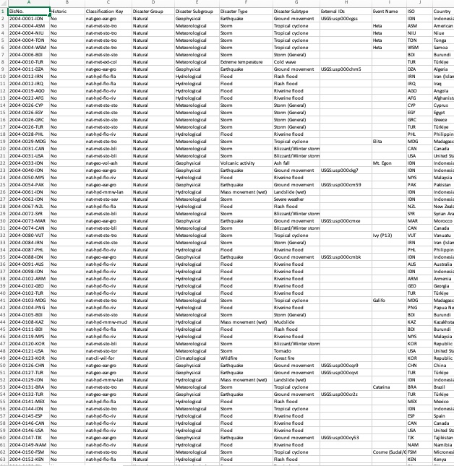
Data Clean Up
- Over 50 columns
- Difficult to manage/visualize data
- Difficult to find data needed
- Drop unwanted columns
- Collect info on remaining columns
- Separate data into easy-to-read Data Frames
- Create new Data Frames with separated data

Slide 4
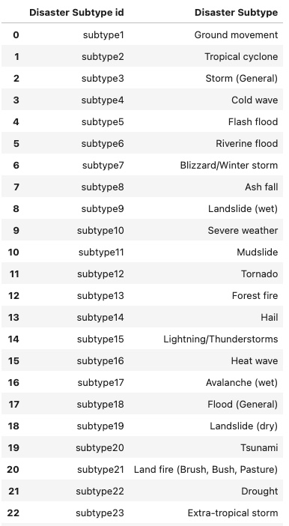
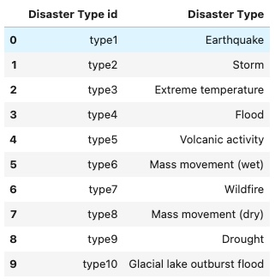
Creating Data Frames
Disaster Subtype
Breaking down Disaster Type and Subtype
Disaster Type

Slide 5
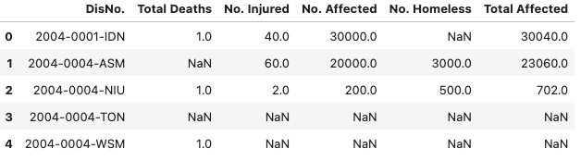
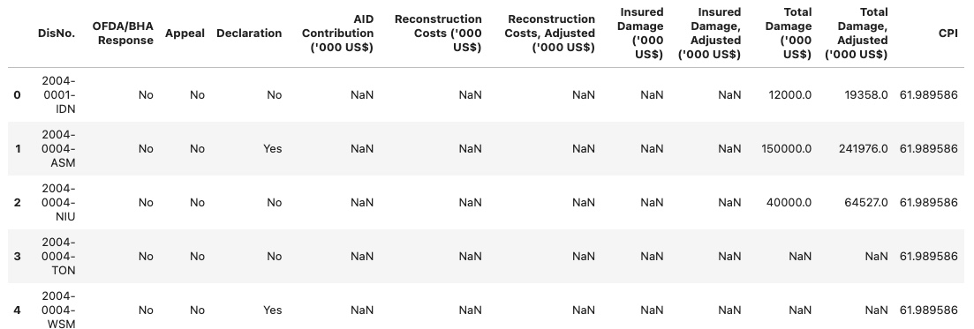
Creating Data Frames
Relevant information in easy-to-read data frames
Lives Affected
Damage Costs

Slide 6
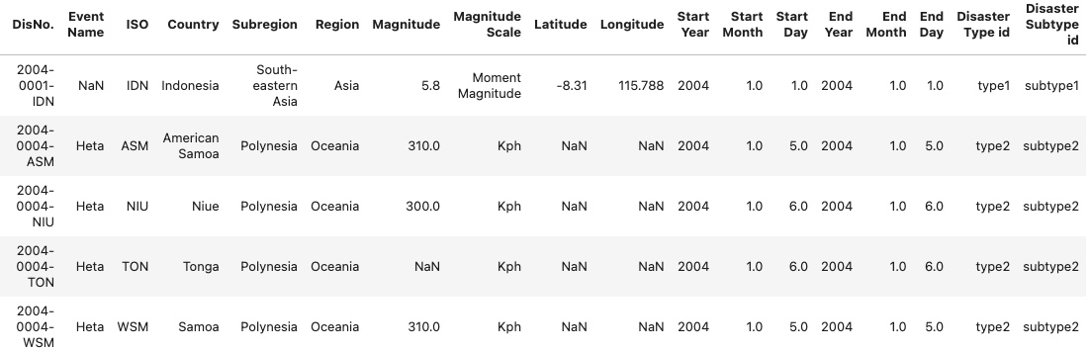
Final Data Frame
Natural Disaster

